Slide 1
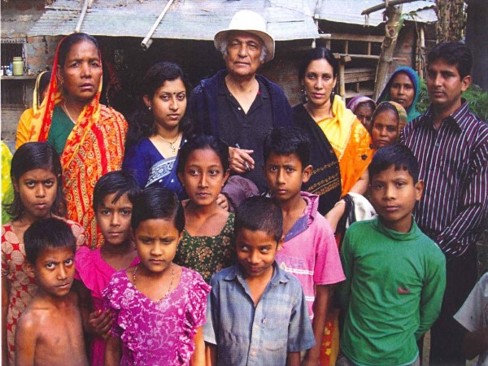
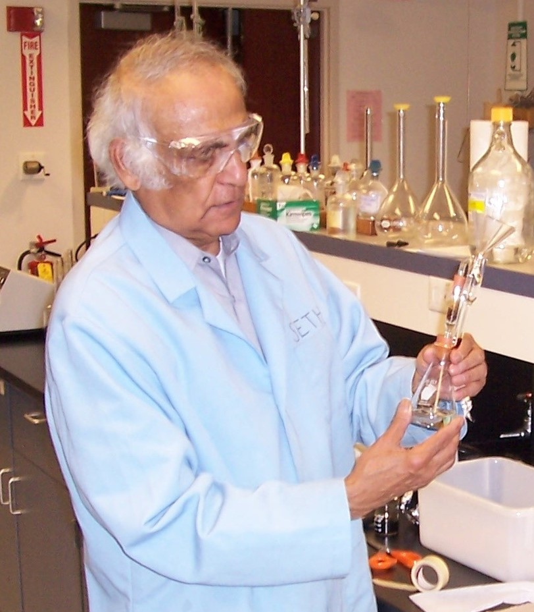
Discovering the Largest Mass Poisoning in History
Arsenic, Manganese, Uranium, and Other Toxic Metals in the Drinking Water of Bangladesh, India, Myanmar, Nepal, and Ultimately the World
A Tribute to Dr. Bibudhendra Sarkar from His Team

Slide 2
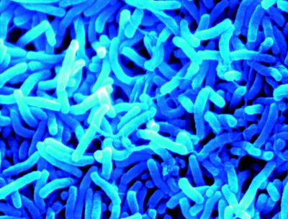
A History of Drinking Water
Surface and dug well water often has microorganisms that can make a person sick hours or days after drinking.
High dissolved oxygen (O₂) and the removal of ions by leaching gives surface and dug well water low concentrations of arsenic (As), manganese (Mn), and other metals.
Vibrio cholera
Mitchell, E.J., S.H. Frisbie, and B. Sarkar. 2011. Exposure to multiple metals from groundwater—a global crisis: Geology, climate change, health effects, testing, and mitigation. Metallomics. 3(9): 874–908.
Photo: Hrozba cholery je stále reálna. Available: http://www.bedekerzdravia.sk/?main=article&id=72 [accessed 28 April 2011].

Slide 3
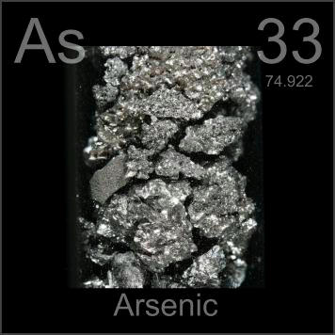
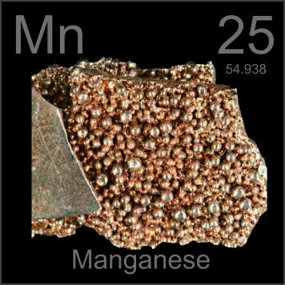
A History of Drinking Water
In contrast, deep well water rarely has pathogenic microorganisms.
Low dissolved O₂ and the accumulation of ions from leaching gives deep well water high concentrations of As, Mn, and other metals that can make a person sick after years or decades of regular drinking.
The diagnosis of chronic metal poisoning is made difficult by the 5 to 20 or more years of exposure needed to produce symptoms.
Arsenic and Manganese
Mitchell, E.J., S.H. Frisbie, and B. Sarkar. 2011. Exposure to multiple metals from groundwater—a global crisis: Geology, climate change, health effects, testing, and mitigation. Metallomics. 3(9): 874–908.
Photos: Gray, T. The Photographic Periodic Table of the Elements. Available: http://periodictable.com/ [accessed 28 April 2011, and 31 July 2015].

Slide 4
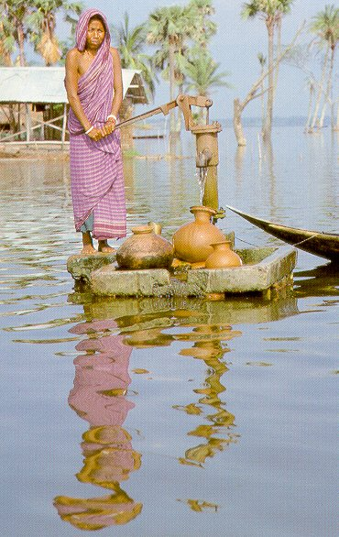
A History of Drinking Water in Bangladesh
Approximately 10,000,000 tubewells have been installed since 1971 to supply safe drinking water.
Within 1 generation the population changed from drinking surface water to drinking groundwater.
By 2000, approximately 97% of Bangladeshis drank tubewell water.
Frisbie SH, Maynard DM, Hoque BA. The nature and extent of arsenic-affected drinking water in Bangladesh. In: Metals and Genetics (Sarkar B, ed). New York: Plenum Publishing Co, 1999; 67–85.
Photo: Brace, S. 1995. Bangladesh. Thomson Learning. New York, NY. P. 9.

Slide 5

A History of Drinking Water in Bangladesh
The symptoms of chronic As poisoning from drinking water usually take 5 to 20 years to manifest.
Chronic As poisoning from drinking tubewell water was first diagnosed in 1993.
Frisbie SH, Maynard DM, Hoque BA. The nature and extent of arsenic-affected drinking water in Bangladesh. In: Metals and Genetics (Sarkar B, ed). New York: Plenum Publishing Co, 1999; 67–85.
Mitchell, E.J., S.H. Frisbie, and B. Sarkar. 2011. Exposure to multiple metals from groundwater—a global crisis: Geology, climate change, health effects, testing, and mitigation. Metallomics. 3(9): 874–908.
Photo: Seth H. Frisbie
Melanosis of the chest

Slide 6
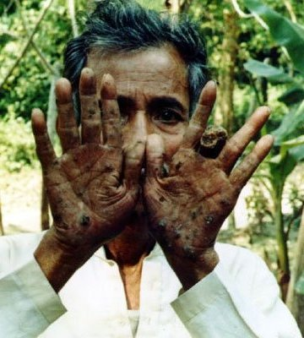
A History of Drinking Water in Bangladesh
The symptoms of chronic As poisoning from drinking water usually take 5 to 20 years to manifest.
Chronic As poisoning from drinking tubewell water was first diagnosed in 1993.
Frisbie SH, Maynard DM, Hoque BA. The nature and extent of arsenic-affected drinking water in Bangladesh. In: Metals and Genetics (Sarkar B, ed). New York: Plenum Publishing Co, 1999; 67–85.
Mitchell, E.J., S.H. Frisbie, and B. Sarkar. 2011. Exposure to multiple metals from groundwater—a global crisis: Geology, climate change, health effects, testing, and mitigation. Metallomics. 3(9): 874–908.
Photo: Dhaka Community Hospital, and R. Wilson. Pictures of Sufferers (Chronic Arsenic Poisoning). Available: http://phys4.harvard.edu/~wilson/arsenic_project_pictures2.html [accessed 7 September 2002].
Keratosis of the palms
(Photograph by Dhaka Community Hospital and Richard Wilson, 2002)

Slide 7
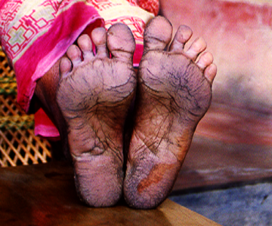
A History of Drinking Water in Bangladesh
The symptoms of chronic As poisoning from drinking water usually take 5 to 20 years to manifest.
Chronic As poisoning from drinking tubewell water was first diagnosed in 1993.
Keratosis of the feet
Frisbie SH, Maynard DM, Hoque BA. The nature and extent of arsenic-affected drinking water in Bangladesh. In: Metals and Genetics (Sarkar B, ed). New York: Plenum Publishing Co, 1999; 67–85.
Mitchell, E.J., S.H. Frisbie, and B. Sarkar. 2011. Exposure to multiple metals from groundwater—a global crisis: Geology, climate change, health effects, testing, and mitigation. Metallomics. 3(9): 874–908.
Photo: Seth H. Frisbie

Slide 8
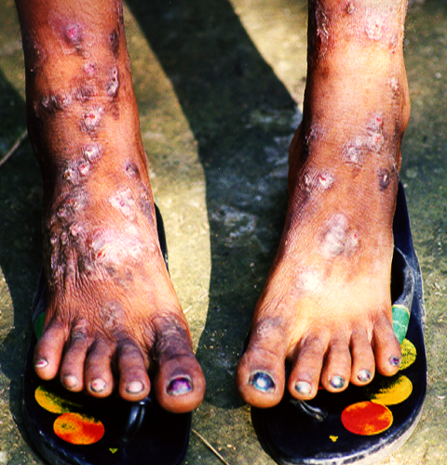
A History of Drinking Water in Bangladesh
The symptoms of chronic As poisoning from drinking water usually take 5 to 20 years to manifest.
Chronic As poisoning from drinking tubewell water was first diagnosed in 1993.
Frisbie SH, Maynard DM, Hoque BA. The nature and extent of arsenic-affected drinking water in Bangladesh. In: Metals and Genetics (Sarkar B, ed). New York: Plenum Publishing Co, 1999; 67–85.
Mitchell, E.J., S.H. Frisbie, and B. Sarkar. 2011. Exposure to multiple metals from groundwater—a global crisis: Geology, climate change, health effects, testing, and mitigation. Metallomics. 3(9): 874–908.
Photo: Seth H. Frisbie
Blackfoot disease

Slide 9
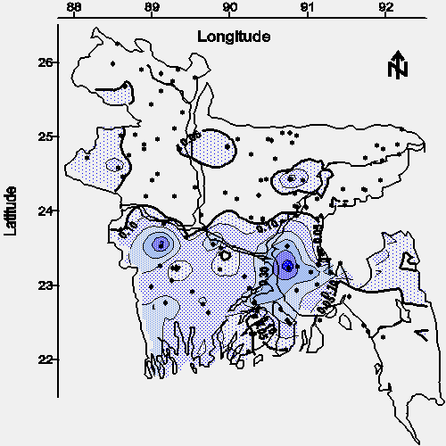
A History of Drinking Water in Bangladesh
We made the first national-scale map of As concentration in Bangladesh’s tubewell water in 1997.
Approximately 75,000,000 Bangladeshis are at risk of death from skin, bladder, liver, and lung cancers caused by chronic As poisoning.
The source of As is geological.
USAID. Report of the Impact of the Bangladesh Rural Electrification Program on Groundwater Quality. Prepared by the Bangladesh Rural Electrification Board. Funded by USAID, Contract No. USAID RE III 388-0070. Dhaka, Bangladesh: USAID, 1997.
Frisbie SH, Maynard DM, Hoque BA. The nature and extent of arsenic-affected drinking water in Bangladesh. In: Metals and Genetics (Sarkar B, ed). New York: Plenum Publishing Co, 1999; 67–85.
Map of As concentration (mg/L)
in Bangladesh.

Slide 10
The Discovery of Other Toxic Elements in Bangladesh’s Drinking Water
Analyte | Independent Standard Recovery (Analyte Added to Distilled Water) | Sample Matrix Spike Recovery (Analyte Added to Drinking Water)
Arsenic (As) | 83% | 89 ± 11%
Ferrous iron (Fe²⁺) | 93 ± 10% | 34 ± 23%
Total iron (Fe) | 95% | Not measured, at least 27% of samples developed the wrong color.
At least 27% of the drinking water wells in Bangladesh contain an analytical interference to the 1,10-phenanthroline methods for measuring ferrous iron and total iron.
USAID. Report of the Impact of the Bangladesh Rural Electrification Program on Groundwater Quality. Prepared by the Bangladesh Rural Electrification Board. Funded by USAID, Contract No. USAID RE III 388-0070. Dhaka, Bangladesh: USAID, 1997.
Frisbie SH, Maynard DM, Hoque BA. The nature and extent of arsenic-affected drinking water in Bangladesh. In: Metals and Genetics (Sarkar B, ed). New York: Plenum Publishing Co, 1999; 67–85.

Slide 11
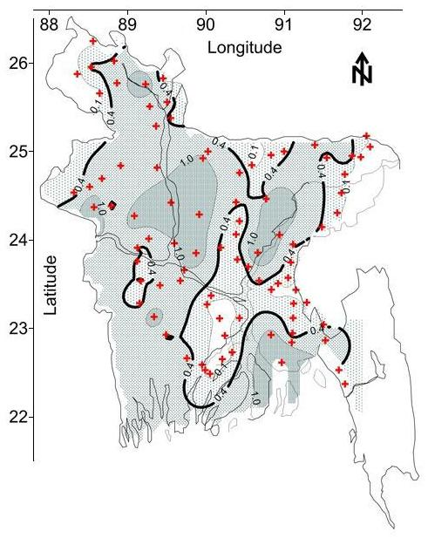
Manganese is Widespread in Drinking Water
60% of Bangladesh’s area contains groundwater with Mn concentrations greater than the WHO Health-based Value.
The discovery of Mn in Bangladesh’s drinking water sparked new research on Mn toxicity in children.
In children, Mn in drinking water causes IQ deficits, learning disabilities, and behavioral problems (eg. ADHD).
In adults, ingestion of Mn has been associated with emotional lability, violent behaviors, and depression.
Ingestion of Mn has also been associated with liver and kidney damage, hearing loss, and inflammation.
Map of Mn concentration (mg/L) in Bangladesh.
Frisbie, S.H., R. Ortega, D.M. Maynard, and B. Sarkar. 2002. The concentrations of arsenic and other toxic elements in Bangladesh’s drinking water. Environmental Health Perspectives. 110(11):1147-1153.
Frisbie, S.H., E.J. Mitchell, H. Dustin, D.M. Maynard, and B. Sarkar. 2012. World Health Organization discontinues its drinking-water guideline for manganese. Environmental Health Perspectives. 120(6): 775–778.
Mitchell, E.J., S.H. Frisbie, and B. Sarkar. 2011. Exposure to multiple metals from groundwater—a global crisis: Geology, climate change, health effects, testing, and mitigation. Metallomics. 3(9): 874–908.
Kresovich JK, Bulka CM, Joyce BT, Vokonas PS, Schwartz J, Baccarelli AA, Hibler EA, Hou L. The inflammatory potential of dietary manganese in a cohort of elderly men. Biological Trace Element Research. 2018; 183:49-57.

Slide 12
Estimated Number of Bangladeshis Drinking Water with Metal Concentrations above WHO Guidelines
Metal | Selected Health Effects | WHO Guideline or Health-based value (µg/L) | Percent of Bangladesh’s Area Exceeding WHO Guideline | Number of Bangladeshis Drinking Unsafe Water ª
As | Known carcinogen | 10 | 49 | 75,000,000
Mn | Neurotoxin | 400 | 60 | 92,000,000
Pb | Neurotoxin, possible carcinogen | 10 | 3 | 4,600,000
Ni | Probable carcinogen | 20 | < 1 | < 1,500,000
Cr | Carcinogen | 50 | < 1 | < 1,500,000
ª Assuming Bangladesh has 158,570,535 people (July 2011 est.) and 97% of its population drinks well water.
We also found Boron (B), barium (Ba), molybdenum (Mo), and uranium (U) above WHO health-based guidelines in Bangladesh.
Frisbie, S.H., R. Ortega, D.M. Maynard, and B. Sarkar. 2002. The concentrations of arsenic and other toxic elements in Bangladesh’s drinking water. Environmental Health Perspectives. 110(11):1147-1153.
Frisbie, S.H., E.J. Mitchell, A.Z. Yusuf, M.Y. Siddiq, R.E. Sanchez, R. Ortega, D.M. Maynard, and B. Sarkar. 2005. The development and use of an innovative laboratory method for measuring arsenic in drinking water from western Bangladesh. Environmental Health Perspectives. 113(9):1196–1204.
Frisbie, S.H., E.J. Mitchell, L.J. Mastera, D.M. Maynard, A.Z. Yusuf, M.Y. Siddiq, R. Ortega, R.K. Dunn, D.S. Westerman, T. Bacquart, and B. Sarkar. 2009. Public health strategies for western Bangladesh that address the arsenic, manganese, uranium and other toxic elements in drinking water. Environmental Health Perspectives. 117(3): 410–416.
Mitchell, E.J., S.H. Frisbie, and B. Sarkar. 2011. Exposure to multiple metals from groundwater—a global crisis: Geology, climate change, health effects, testing, and mitigation. Metallomics. 3(9): 874–908.
World Health Organization (WHO). Guidelines for drinking-water quality. Fourth edition incorporating the first addendum. 4th ed. Geneva: WHO; 2017. p. 1,27,161,164.

Slide 13
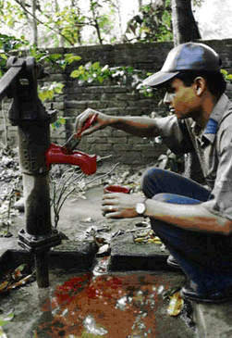
Testing Can Provide Safe Water to Millions
As a result of our work, groundwater testing has become a major component of an overall strategy for providing safe drinking water to the people of Bangladesh.
Tubewells are considered safe and marked with green paint if the As concentration is less than or equal to the 50 µg/L national standard.
Conversely, tubewells are considered unsafe and marked with red paint if the As concentration is greater than 50 µg/L.
Our survey research shows Bangladeshis will readily share and gather water from safe tubewells.
Frisbie, S.H., R. Ortega, D.M. Maynard, and B. Sarkar. 2002. The concentrations of arsenic and other toxic elements in Bangladesh’s drinking water. Environmental Health Perspectives. 110(11):1147-1153.
Frisbie, S.H., E.J. Mitchell, A.Z. Yusuf, M.Y. Siddiq, R.E. Sanchez, R. Ortega, D.M. Maynard, and B. Sarkar. 2005. The development and use of an innovative laboratory method for measuring arsenic in drinking water from western Bangladesh. Environmental Health Perspectives. 113(9):1196–1204.
Frisbie, S.H., E.J. Mitchell, L.J. Mastera, D.M. Maynard, A.Z. Yusuf, M.Y. Siddiq, R. Ortega, R.K. Dunn, D.S. Westerman, T. Bacquart, and B. Sarkar. 2009. Public health strategies for western Bangladesh that address the arsenic, manganese, uranium and other toxic elements in drinking water. Environmental Health Perspectives. 117(3): 410–416.
Photo: The World Bank Group, 2005. Available: http://wbln1018.worldbank.org [accessed 22 February 2005.

Slide 14
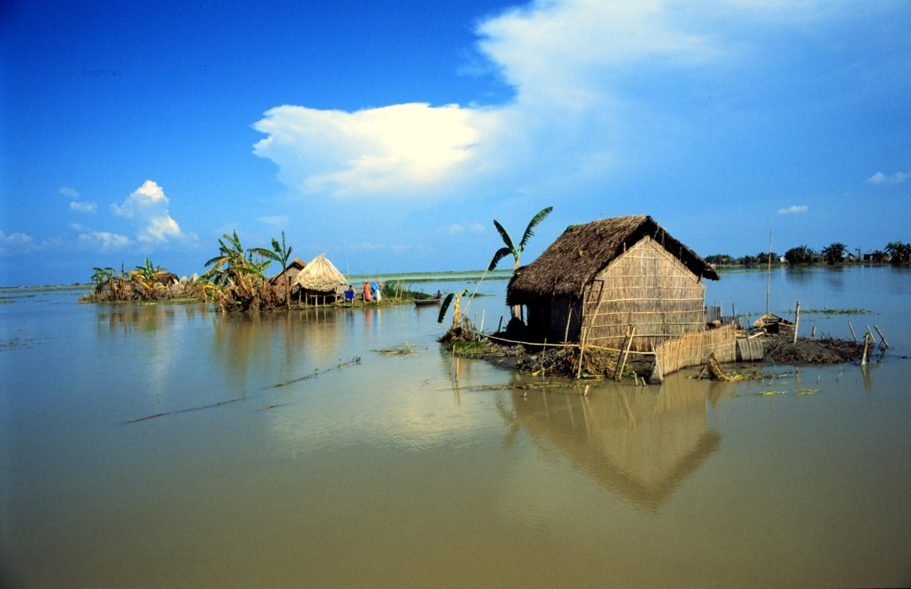
Climate Change and Multimetal
Exposure in Bangladesh
Most of Bangladesh is less than 12 meters above sea level.
In a normal monsoon season one-third of the cultivated land is flooded with a mixture of fresh and saltwater.
Flooding will likely increase the concentrations of As, Mn, and other metals by creating a reducing environment and by ion exchange
Mitchell, E.J., S.H. Frisbie, and B. Sarkar. 2011. Exposure to multiple metals from groundwater—a global crisis: Geology, climate change, health effects, testing, and mitigation. Metallomics. 3(9): 874–908.
Photo: Shahin Ullah.

Slide 15
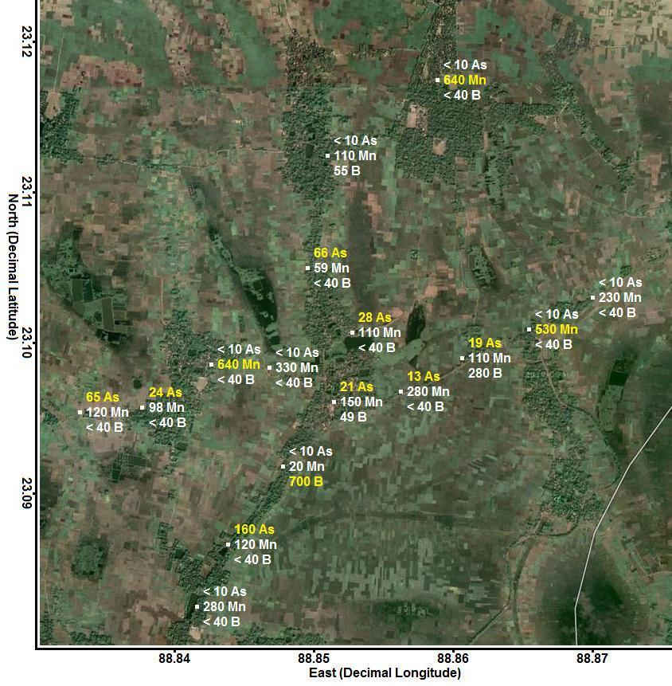
The Discovery of Multiple Toxic Elements in
West Bengal’s Drinking Water
In West Bengal, India, we found unsafe concentrations of As, B, fluoride (F⁻), Mn, and possibly thorium (Th).
Bacquart, T., K. Bradshaw, S.H. Frisbie, E.J. Mitchell, G. Springston, J. Defelice, H. Dustin, and B. Sarkar. 2012. A survey of arsenic, manganese, boron, thorium, and other toxic metals in the groundwater of a West Bengal, India neighbourhood. Metallomics. 7(4): 653–659.

Slide 16
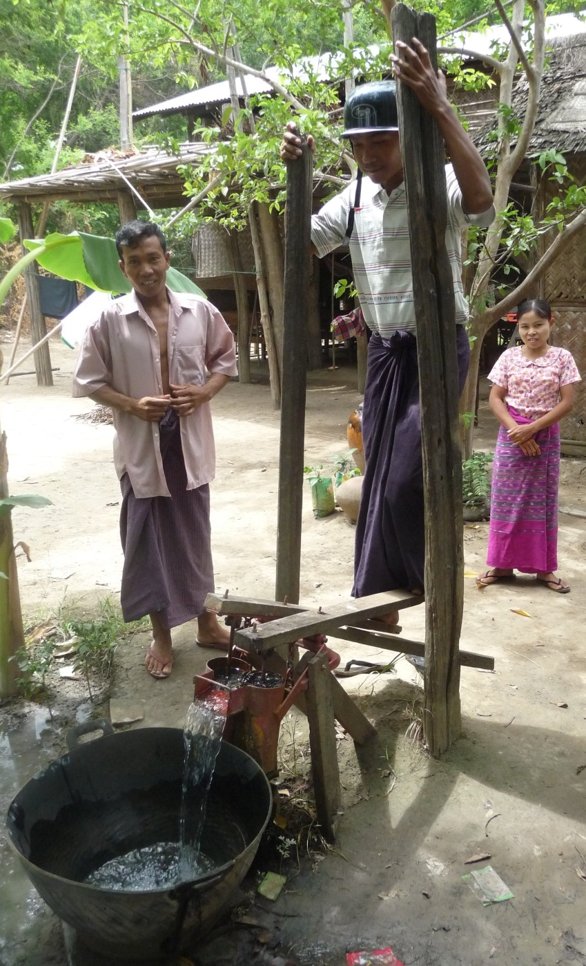
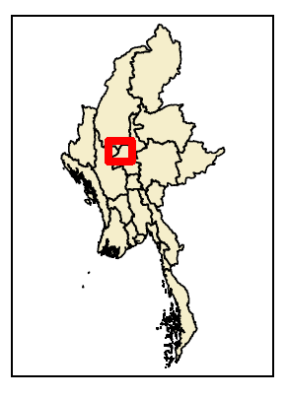
The Discovery of Multiple Toxic Elements in
Myanmar’s Drinking Water
In Myanmar, we found unsafe concentrations of As, F⁻, Mn, and U.
Bacquart, T., S. H. Frisbie, E.J. Mitchell, L. Grigg, C. Cole, C. Small, and B. Sarkar. 2015. Multiple inorganic toxic substances contaminating the groundwater of Myingyan Township, Myanmar: Arsenic, manganese, fluoride, iron, and uranium. Science of the Total Environment. 517:232–245.
Photo: Manja Uhlig.

Slide 17
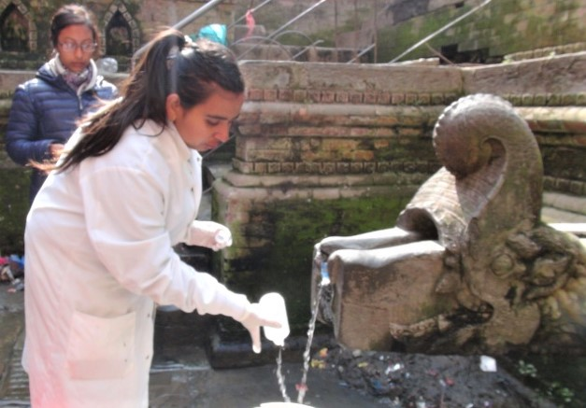
Nepal: Health Effects Associated with Multiple Metals Exposure in Drinking Water
In Nepal, we found drinking water from various types of sources in Kathmandu Valley exceeded WHO guidelines and Nepali standards for Al, As, Fe, and Mn.
High Mn levels do not deter residents from drinking the water.
People drinking water with higher Pb concentrations had poorer attitudes towards education.
Sarkar, B. Mitchell, E. Frisbie, S, Grigg, L. Maskey, R., Adhikari, S. Drinking Water Contaminants and Public Health in the Kathmandu Valley, Nepal after the 2015 Gorkha Earthquake. In preparation.

Slide 18
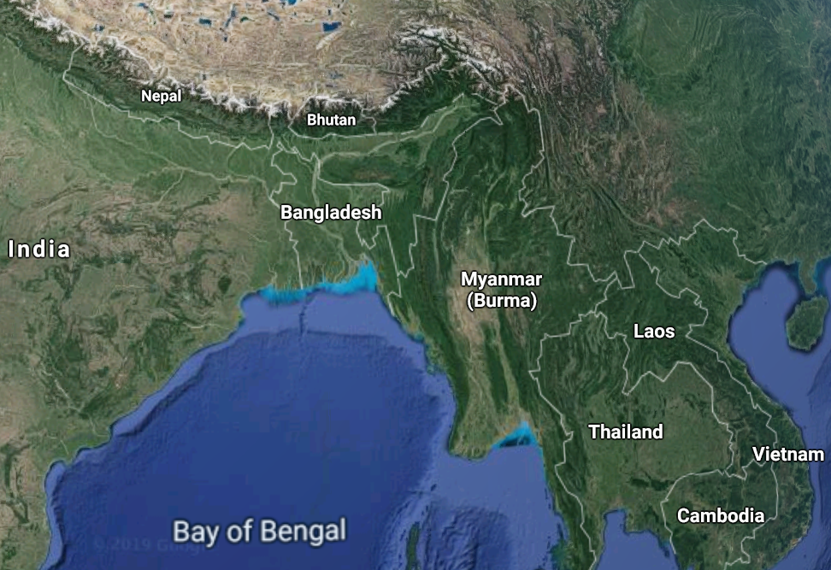
The Discovery of Multiple Toxic Elements in
South Asia’s Drinking Water
The rapid switch to drinking deep well water is exposing hundreds of millions of people in south Asia to unsafe concentrations of metals.
This has been called the largest mass poisoning in history.
Photo: Google Maps. Southern Asia. Available: https://www.google.com/maps/ [accessed 27 August 2019].

Slide 19
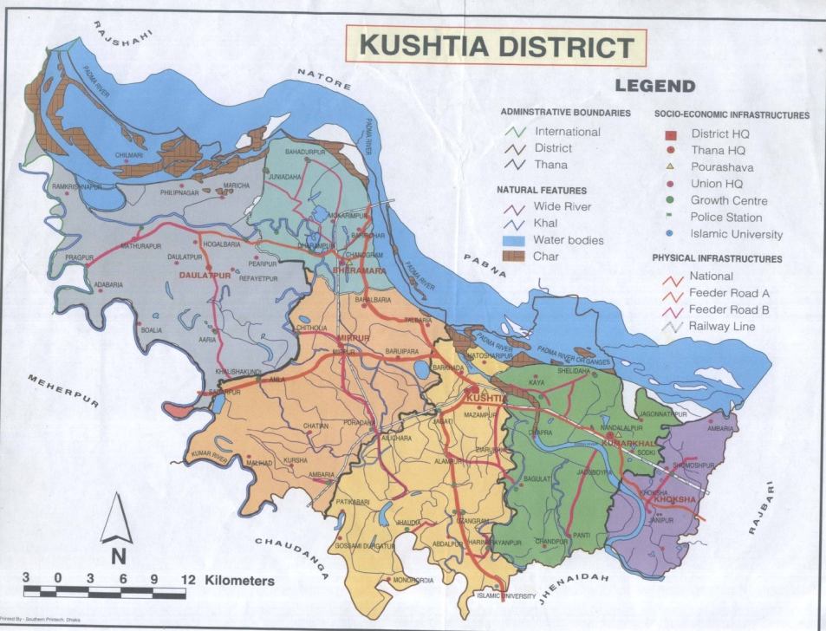
Studies on As Exposure, Pregnancy Outcomes, and Child Neurodevelopment
Env. Health Perspect. (2002) 110, 1147-1153
Bheramara

Slide 20
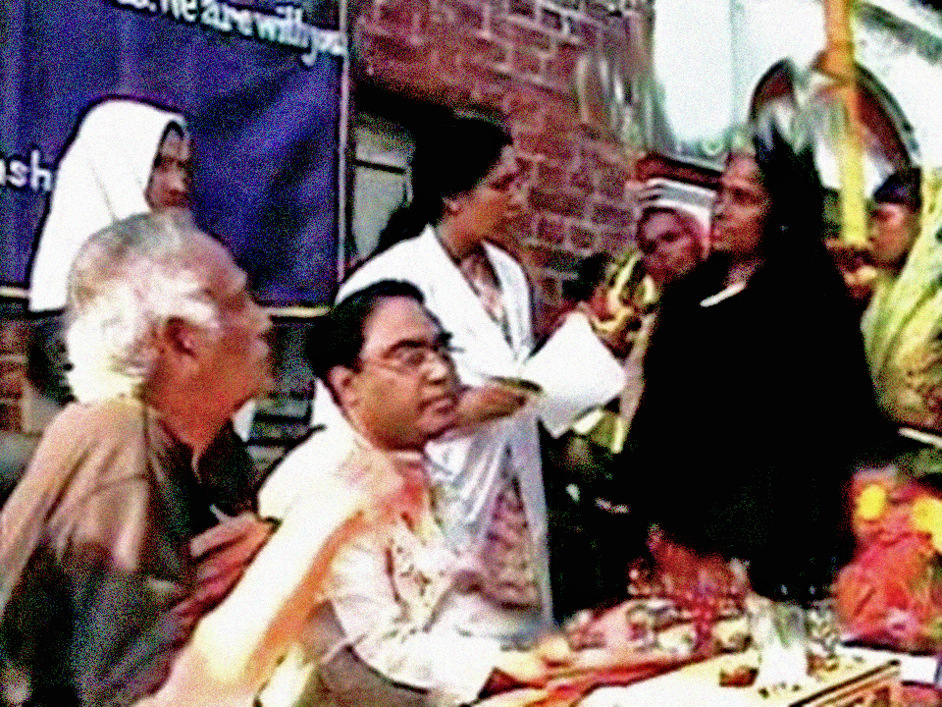
Pregnancy Outcomes of Arsenic-affected Women
In Bheramara, Bangladesh, we are studying pregnancy outcomes of women showing As symptoms.
Prospective, observational, cross-sectional, non-invasive study
Population: 154 women responding to a maternal health survey
  77 showing As symptoms (consecutively selected)
  77 controls with no symptoms
Municipal water testing results showed study population was drinking water with high As.
Ashraf F, Mustanzid S, Sarkar, B. Adverse pregnancy outcomes associated with maternal arsenic symptoms. In preparation.
In Progress

Slide 21
Pregnancy Outcomes of Arsenic-affected
Findings: Maternal As symptoms are associated with increased incidence of stillbirth, spontaneous abortion, eclampsia, PPH, infant death, and neonatal death.
Ashraf F, Mustanzid S, Sarkar, B. Adverse pregnancy outcomes associated with maternal arsenic symptoms. In preparation.

Slide 22
Arsenic Exposure and Child Behavior in Bangladesh
In Bheramara, Bangladesh, we are also studying arsenic exposure and child behavior.
Study population: 300 children ages 5-15 years whose parents responded to a community health survey
  150 exposed to As in drinking water (consecutively selected)
  150 not exposed to As
Ashraf F, Mustanzid S, Sarkar, B. Arsenic exposure and child behavior in Bangladesh. In preparation.

Slide 23
Arsenic Exposure and Child Behavior: Preliminary Results
Good
Mediocre
Poor
Ashraf F, Mustanzid S, Sarkar, B. Arsenic exposure and child behavior in Bangladesh. In preparation.

Slide 24

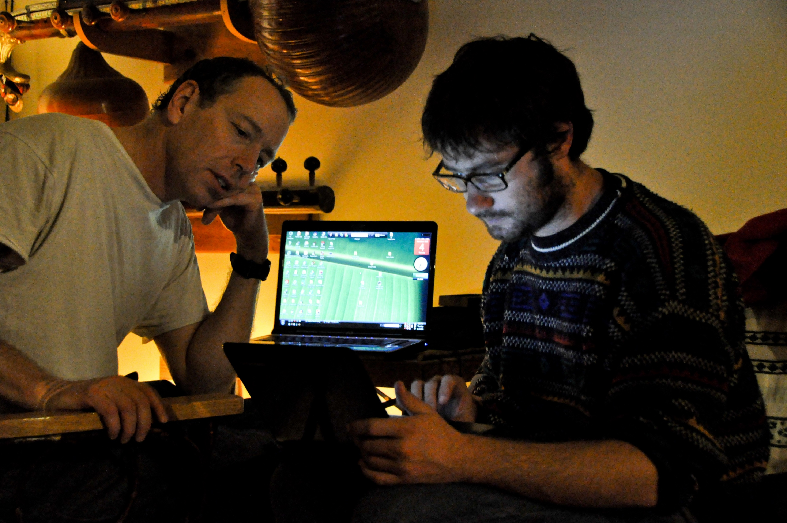
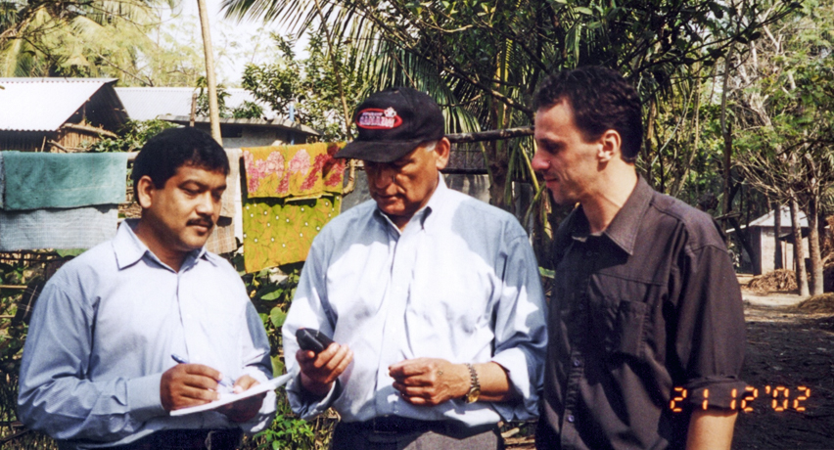
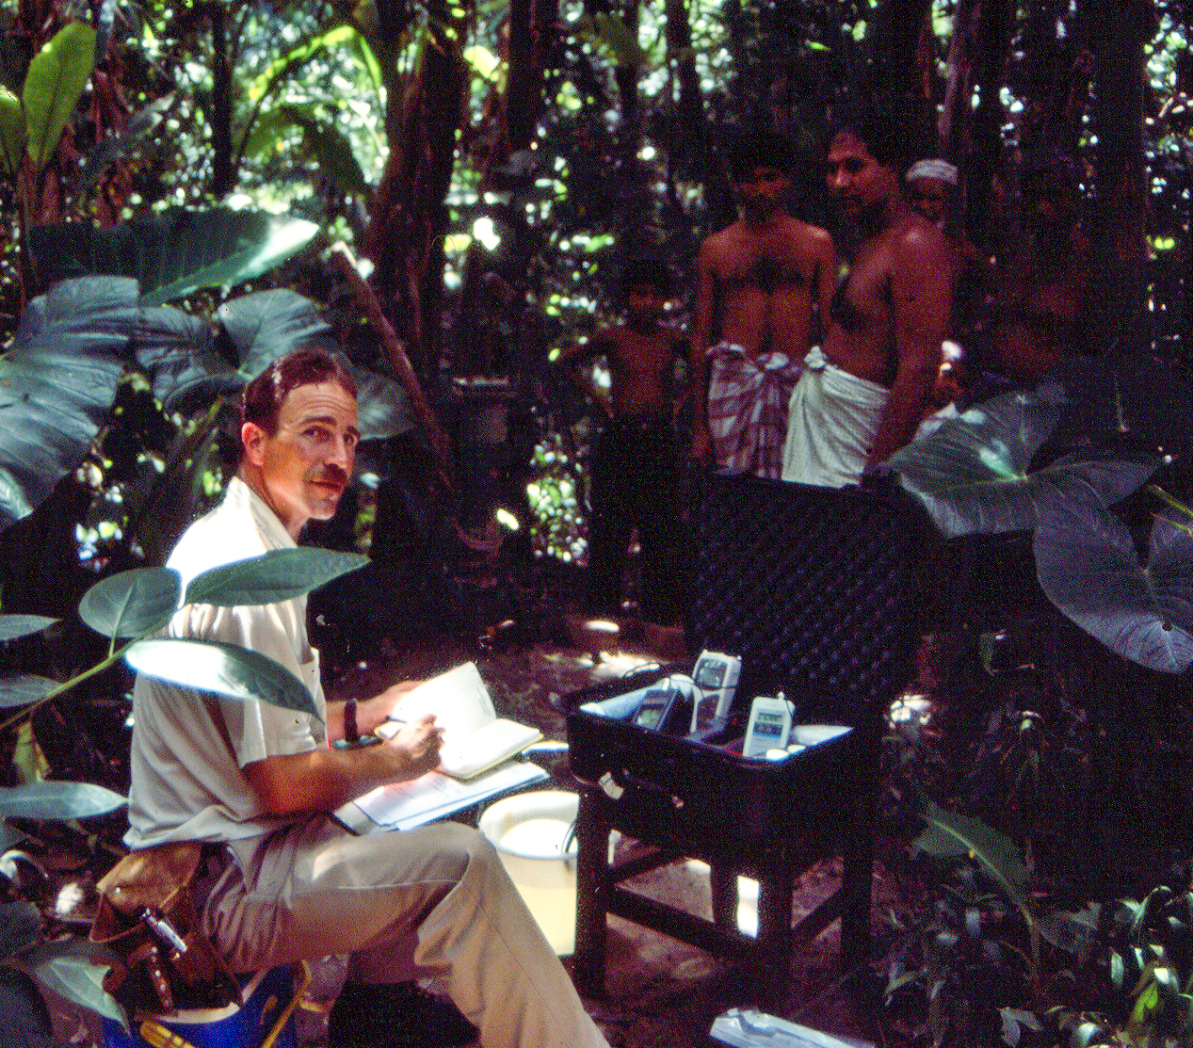
Thank you, Dr. Sarkar!

